Slide 1
Transaction Management

Slide 2


Slide 3
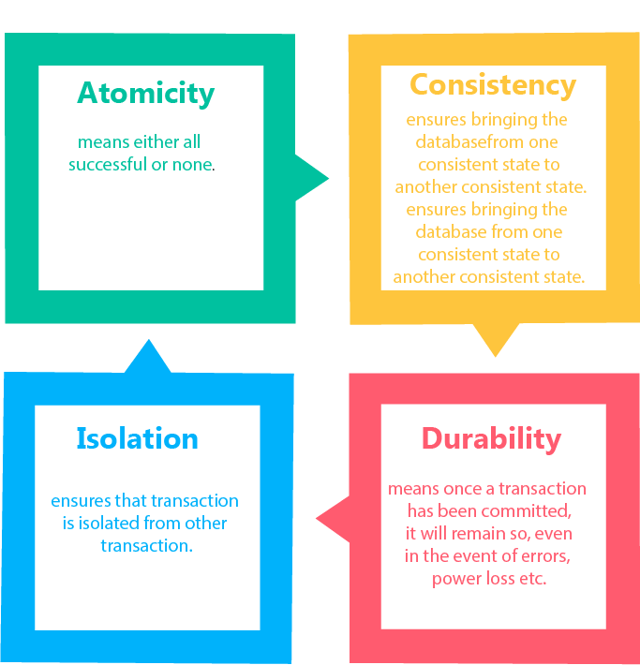
Properties of Transactions
ACID
Properties

Slide 4
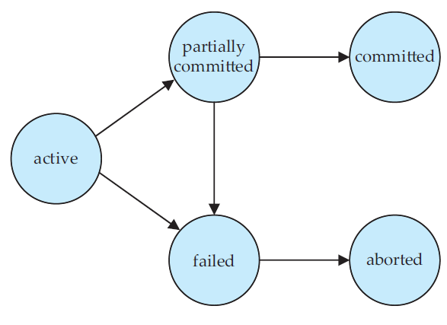
State Diagram of a Transaction

Slide 5
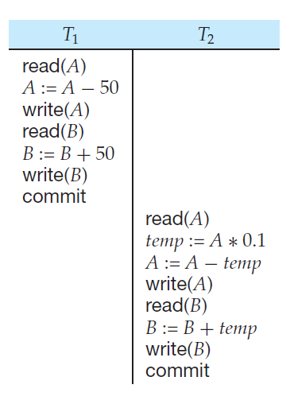
A=100
B=200
A+B=300
Time
A serial schedule in which T1 is followed by T2

Slide 6
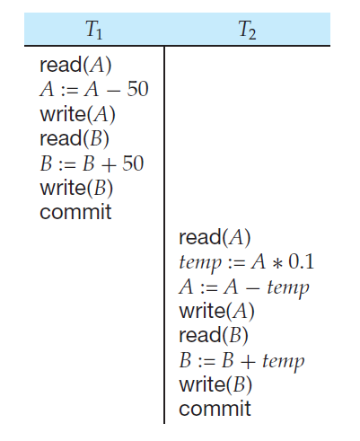
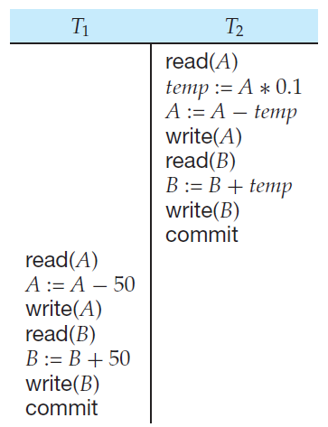
Time
sum A + B is preserved

Slide 7
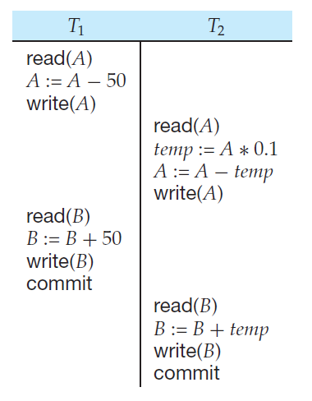
a serial schedule
a concurrent schedule

Slide 8
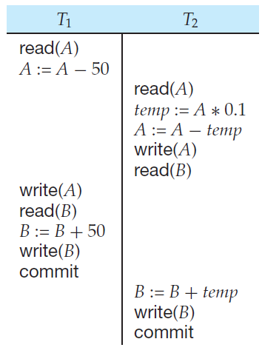
a concurrent schedule resulting in an inconsistent state
a concurrent schedule

Slide 9
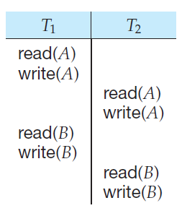
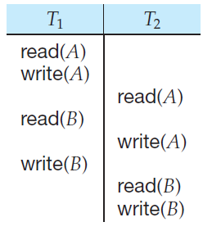
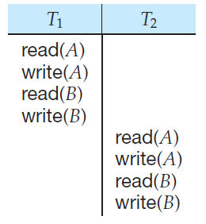
Conflict Serializability

Slide 10
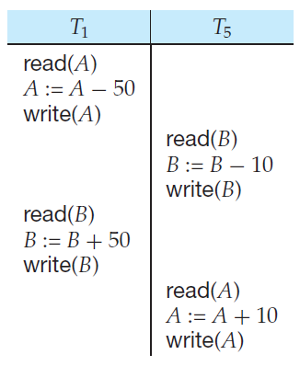
not serializable

Slide 11
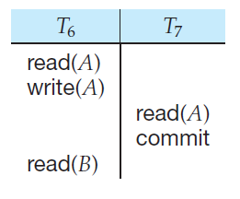
a non recoverable schedule

Slide 12
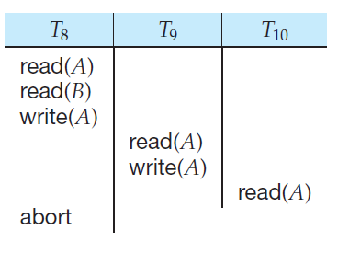
cascading rollback of transactions

Slide 13
Concurrency can be achieved by:
Locking
TimeStamp

Slide 14
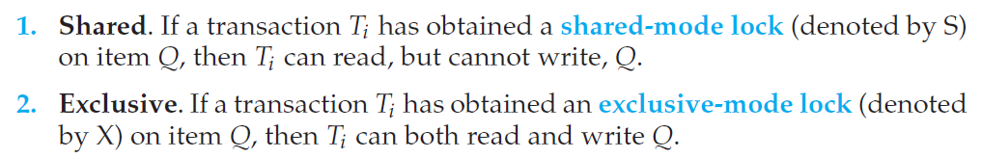
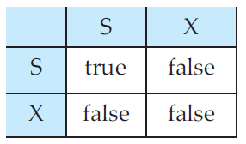
Locks
Lock-compatibility matrix

Slide 15
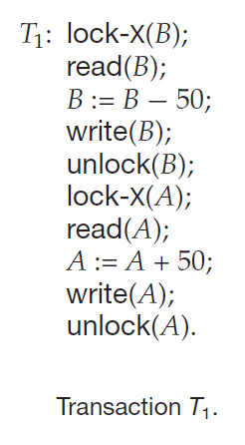
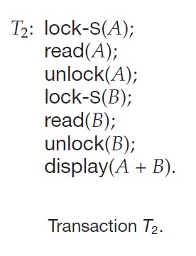

Slide 16
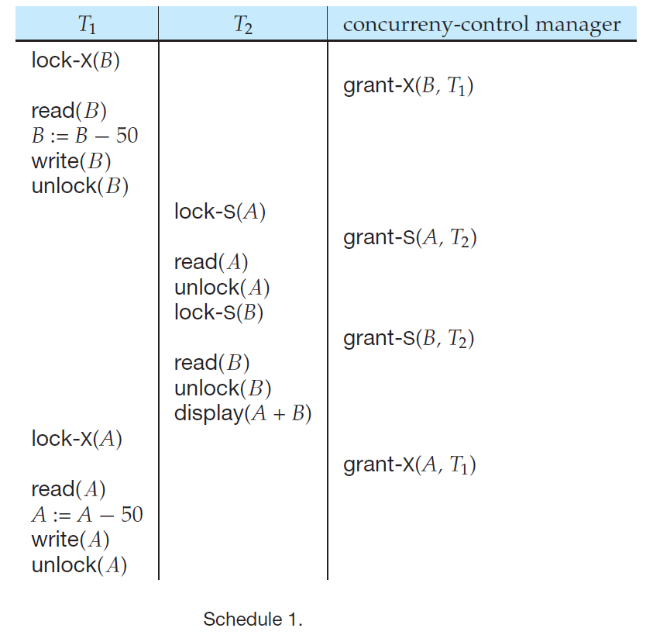

Slide 17
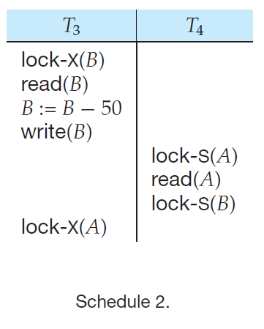

Slide 18
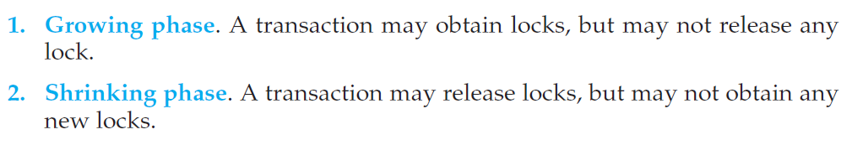
The Two-Phase Locking Protocol
Advantages: 1. Ensures conflict serializability | Dis-advantages: Deadlock Cascading rollback of transactions

Slide 19
Strict two-phase locking protocol
Rigorous two-phase locking protocol
Advantages:
Ensures Conflict Serializability
Deadlock free
Advantages:
Starvation

Slide 20
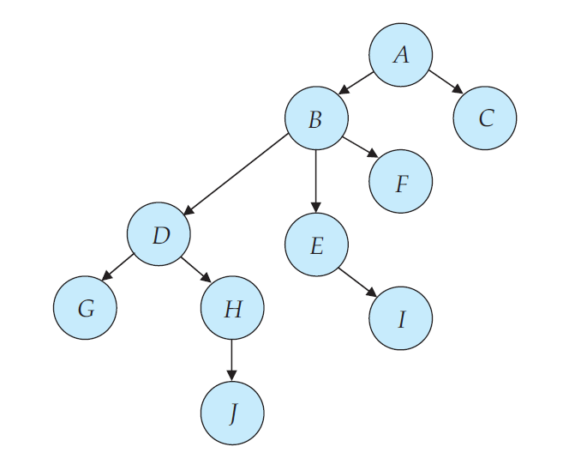
Graph-Based Protocols

Slide 21
Advantages:
Ensures Conflict Serializability
Deadlock free
Disadvantages:
Prolonged Starvation
Unnecessary locking of data items
To lock entire database every data node must be locked

Slide 22
Multiple Granularity
A more efficient way to gain this knowledge is to introduce a new class of lock modes, called intention lock modes.
If a node is locked in intention-shared (IS) mode, explicit locking is being done at a lower level of the tree, but with only shared-mode locks.
If a node is locked in intention-exclusive (IX) mode, then explicit locking is being done at a lower level, with exclusive-mode or shared-mode locks.
If a node is locked in shared and intention-exclusive (SIX) mode, the subtree rooted by that node is locked explicitly in shared mode, and that explicit locking is being done at a lower level with exclusive-mode locks.

Slide 23
Wants to lock in | Parents must be locked in
S or IS | IS or IX
X or IX or SIX | IX or SIX

Slide 24
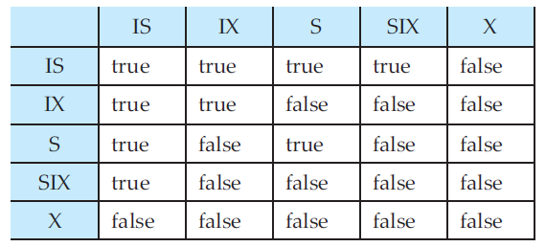

Slide 25
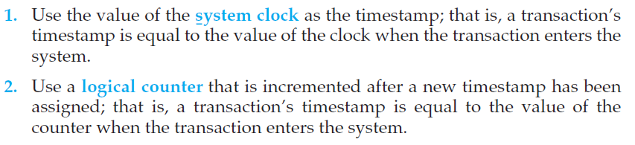
Timestamp-Based Protocols
TS(T_{i} )
TS(T_{i} ) < TS(T_{j} )

Slide 26
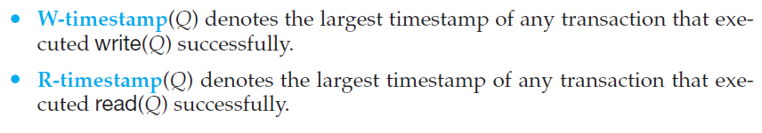

Slide 27
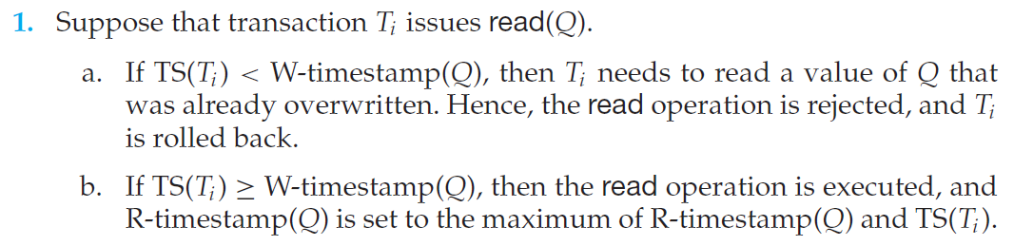

Slide 28
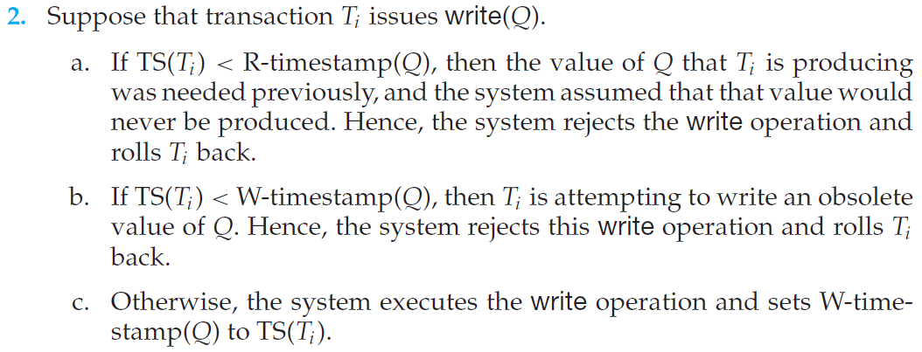

Slide 29
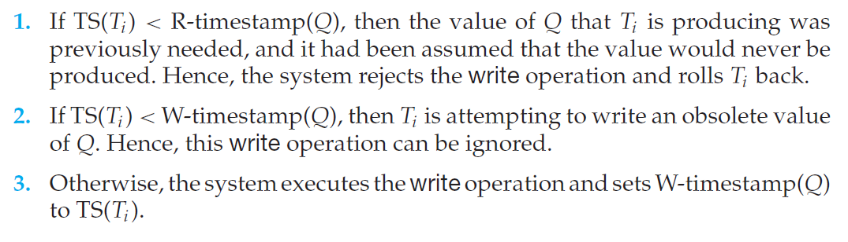
Thomas’ Write Rule

Slide 30
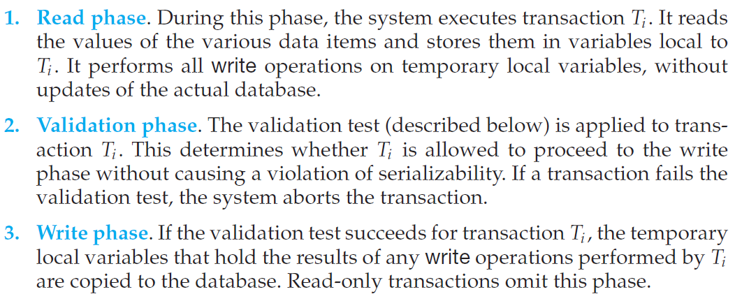
Validation-Based Protocol

Slide 31
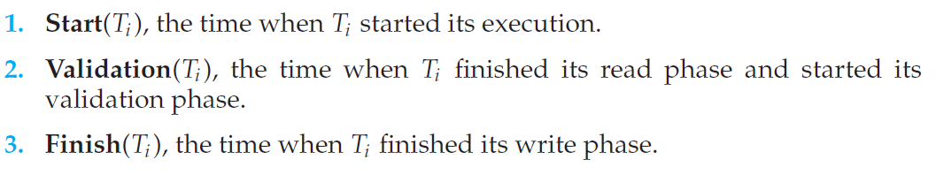

Slide 32
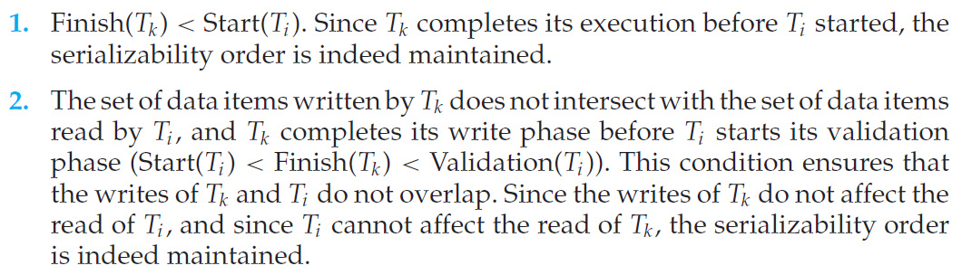
This validation scheme is called the optimistic concurrency-control scheme

Slide 33
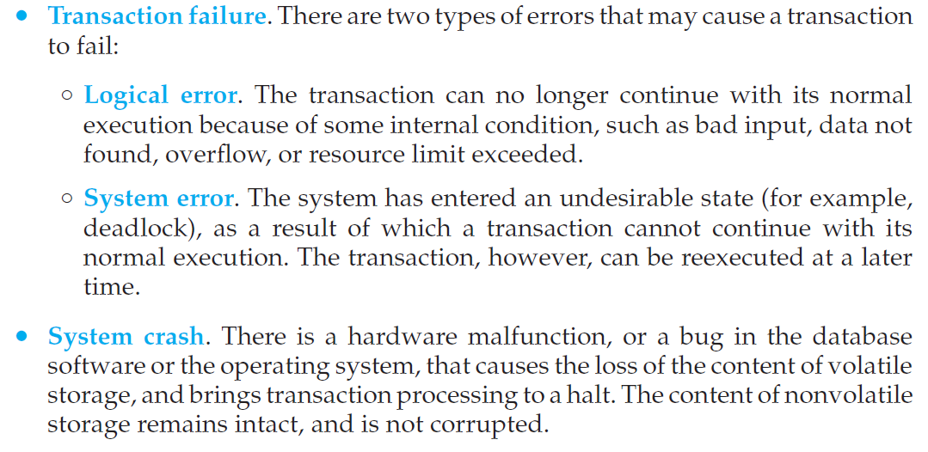
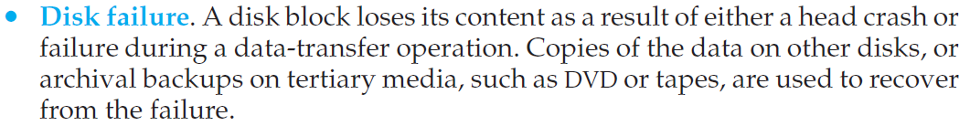
Failure Classification

Slide 34
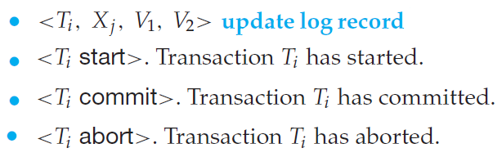
Log
The log is a sequence of log records, recording all the update activities in the database.

Slide 35
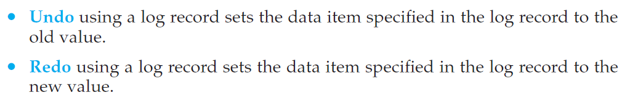

Slide 36
Differed log based recovery |  | Immediate log based recovery
Log | Disk | Log | Disk
<T1, start> <T1, A, 100, 200> | A = 100 | <T1, start> <T1, A, 100, 200> | A=100 A=200
Transaction Failed or System crash No Recovery |  | Transaction failed or System crash Recovery: Undo(T1)

Slide 37
Differed log based recovery |  | Immediate log based recovery
Log | Disk | Log | Disk
<T1, start> <T1, A, 100, 200> <T1, commit> | A = 100 A=200 | <T1, start> <T1, A, 100, 200> <T1, commit> | A=100 A=200
Transaction Failed or System crash Recovery: Redo(T1) |  | Transaction failed or System crash Recovery: Redo (T1)

Slide 38
Differed log based recovery |  | Immediate log based recovery
Log | Disk | Log | Disk
<T1, start> <T1, A, 100, 200> <T1, commit> <T2, start> <T2, A, 200, 350> | A = 100 A=200 | <T1, start> <T1, A, 100, 200> <T1, commit> <T2, start> <T2, A, 200, 350> | A=100 A=200 A=350
Transaction Failed or System crash Recovery: Redo(T1) |  | Transaction failed or System crash Recovery: Redo (T1) & Undo(T2)

Slide 39
Deadlock Prevention
Wait-die
Ex: TS(T1) < TS(T2) < TS(T3)
Data item Q is under control of T2
T1 & T3 are requesting for Q
T1 is kept in waiting state
T3 is roll backed
Wound-wait
Ex: TS(T1) < TS(T2) < TS(T3)
Data item Q is under control of T2
T1 & T3 are requesting for Q
T1 gets the data item Q
T2 is roll backed
T3 is kept in waiting sstate

Slide 40
Deadlock Detection
Deadlocks can be described precisely in terms of a directed graph called a wait for graph.
Recovery from Deadlock
Selection of a victim
Rollback
Starvation

